Slide 1
Adventures in Communicating the Value of Campus CI Investment
Preston Smith
Metrics 2023
Denver, CO
November 11, 2023

Slide 2
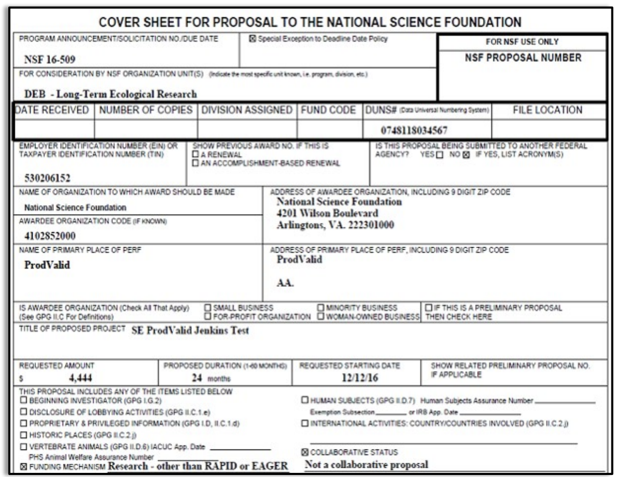
Problem: finding investment for your Campus CI?
The federal government has several programs to consider.. NSF CC* is excellent for campus resources.
Also MRI, instrumentation programs from NIH (S10), DOD (DURIP), etc.
“The proposal is expected to document long term commitment to operations and maintenance (O&M) past the lifetime of the award - or describe the strategy for sustaining availability of the resource.”

Slide 3

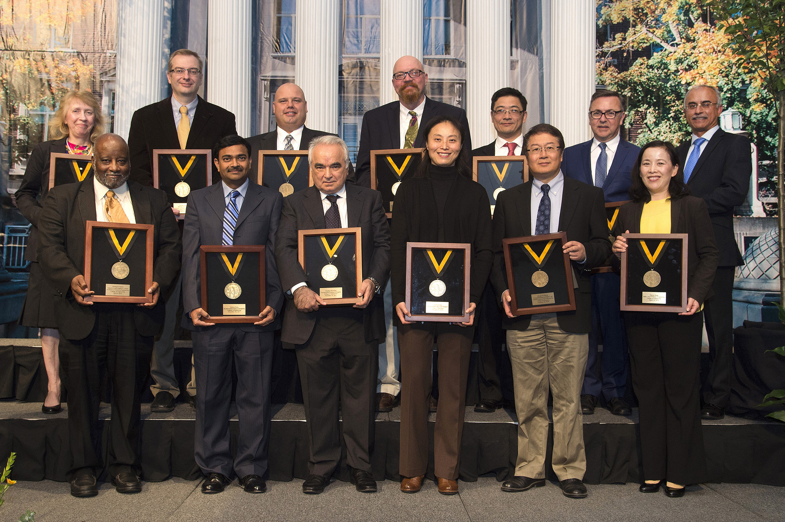
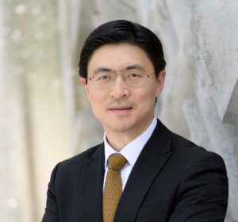
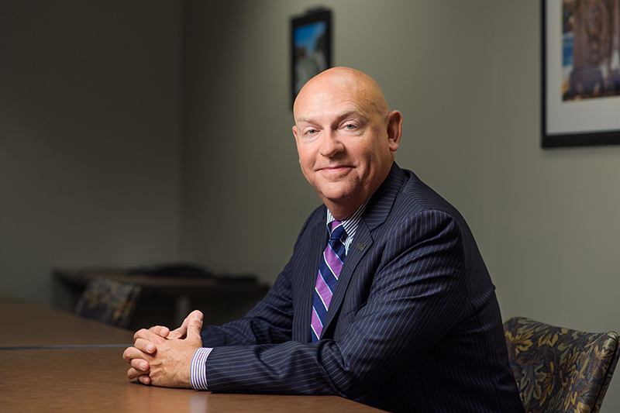
Campus Cyberinfrastucture
A Coordinated Investment by Many Stakeholders
NSF and other agencies
Campuses
CIOs
VPRs
Faculty
My talk will focus mostly on the local stakeholders!

Slide 4

Communicating Value
Hot Take: Our Community is Immature at Communicating Value
Questions we received at Purdue from finance leaders:
“What do they keep spending all that money on for supercomputers?”
“Who even uses these things? Are they just vanity toys for a couple of people?”
“Why is that recharge center not covering its costs?”
Which I understand.. Even if you do recover all the costs, the VALUE is returned somewhere else than your center’s books.

Slide 5
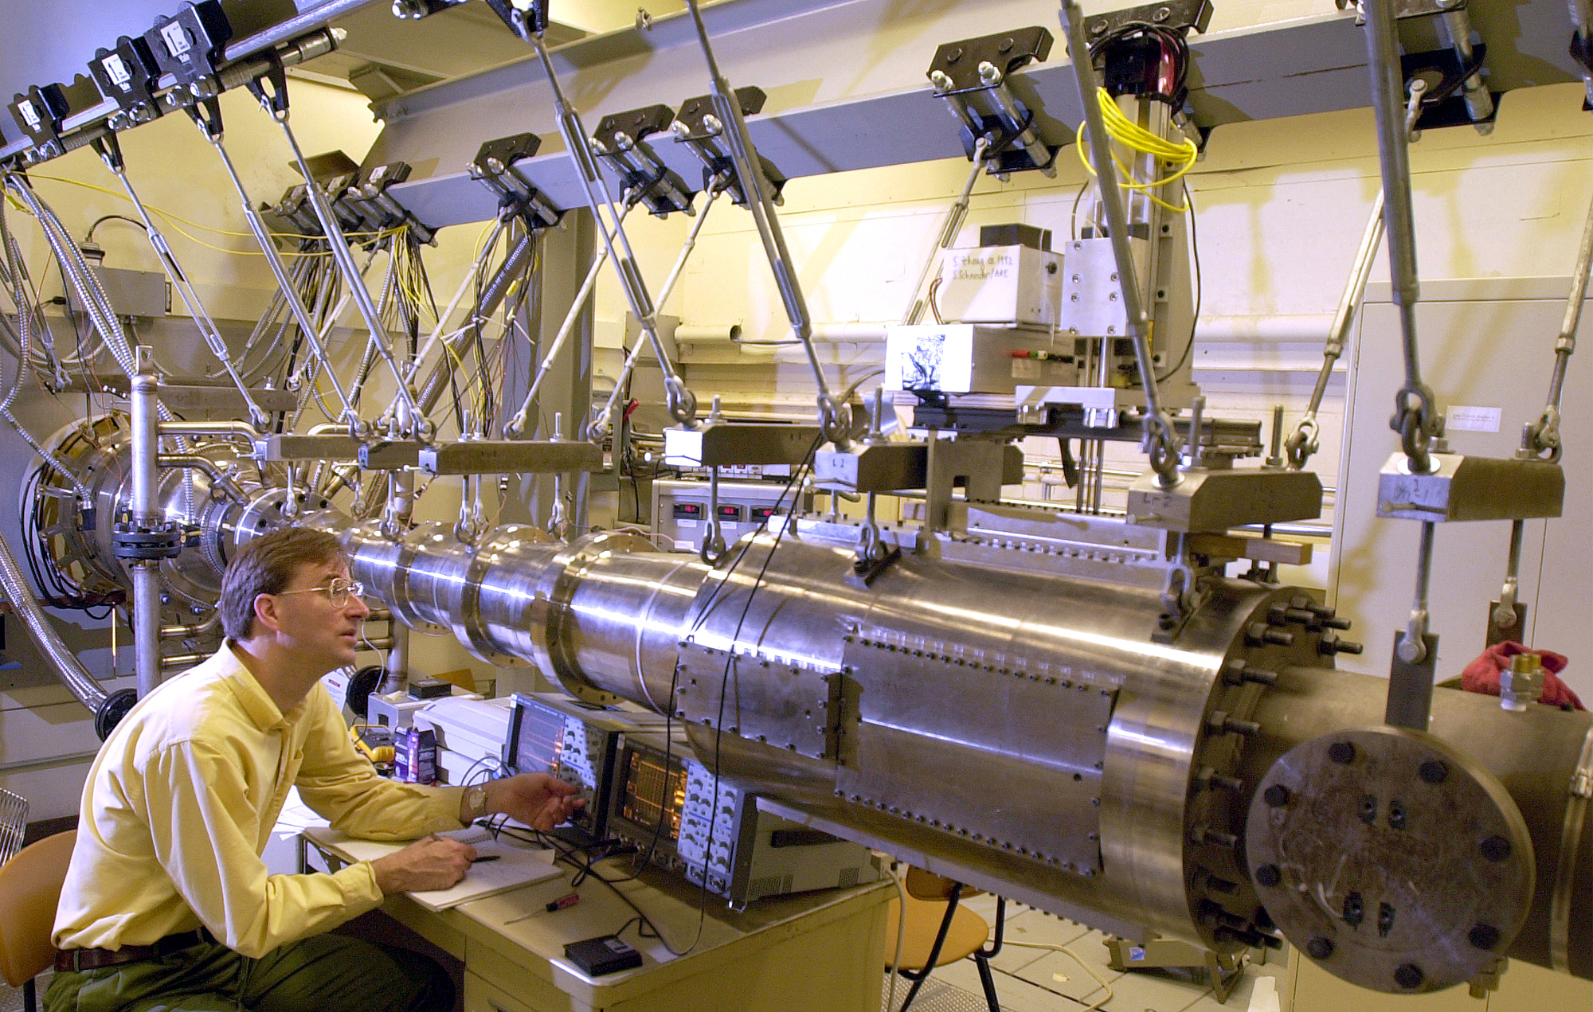
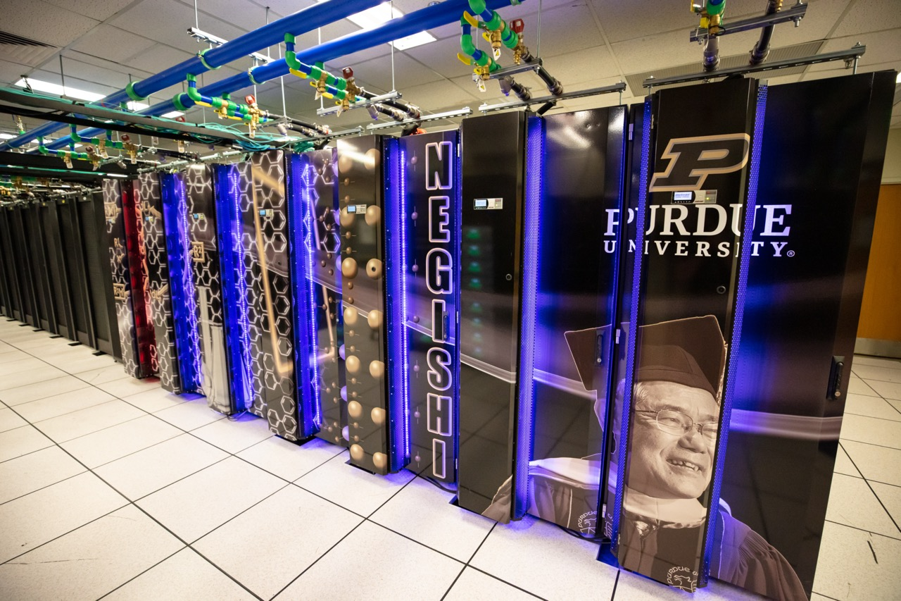
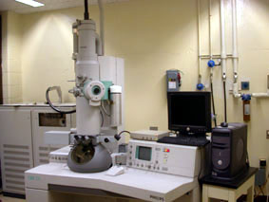
Motivation
Value of HPC investments
Computing systems are critical pieces of research infrastructure
Administrators have to manage competing priorities of infrastructures in which to invest:
Supercomputers
Wind tunnels
Electron Microscopes
Enterprise IT vs research IT
Etc
How to demonstrate that computational research is a good investment?

Slide 6
Step 1: Know your Stakeholders
Which specific stakeholders are you communicating value to?
What is important at the institution at this point in time?

Slide 7
Personas
Faculty: getting next grant, publishing, graduating students
Deans, Heads, Chairs: Students, educational outcomes, Faculty recruitment and retention, Having appropriate infrastructure for their units to succeed, happy faculty
VP for Research: Competitiveness for funding, winning major grants and contracts, growing R&D expenditures, tech transfer, IP, happy faculty
Provost: Students, educational outcomes, happy faculty
CFO: $$$ - ROI, efficiency, reduction of expense, increase of revenue
CIO: Contributing to the mission
Stakeholder Interests

Slide 8
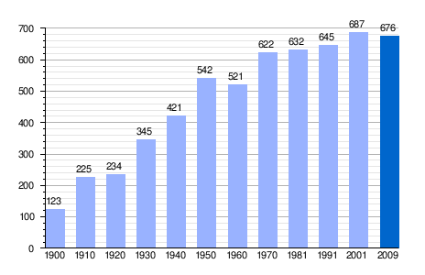
Step 2: Have Quantitative Center Metrics
Telling your story
.. based on the interests of the specific stakeholder, given the institution’s priorities in the current context
If you don’t track your usage, and map it to who your PIs are and where they sit in your institution, start doing so now! (Install XDMOD!)
Notes:
I’m not going to go into a detail here except to refer back to the stakeholder personas before – frame your metrics to address their interests

Slide 9
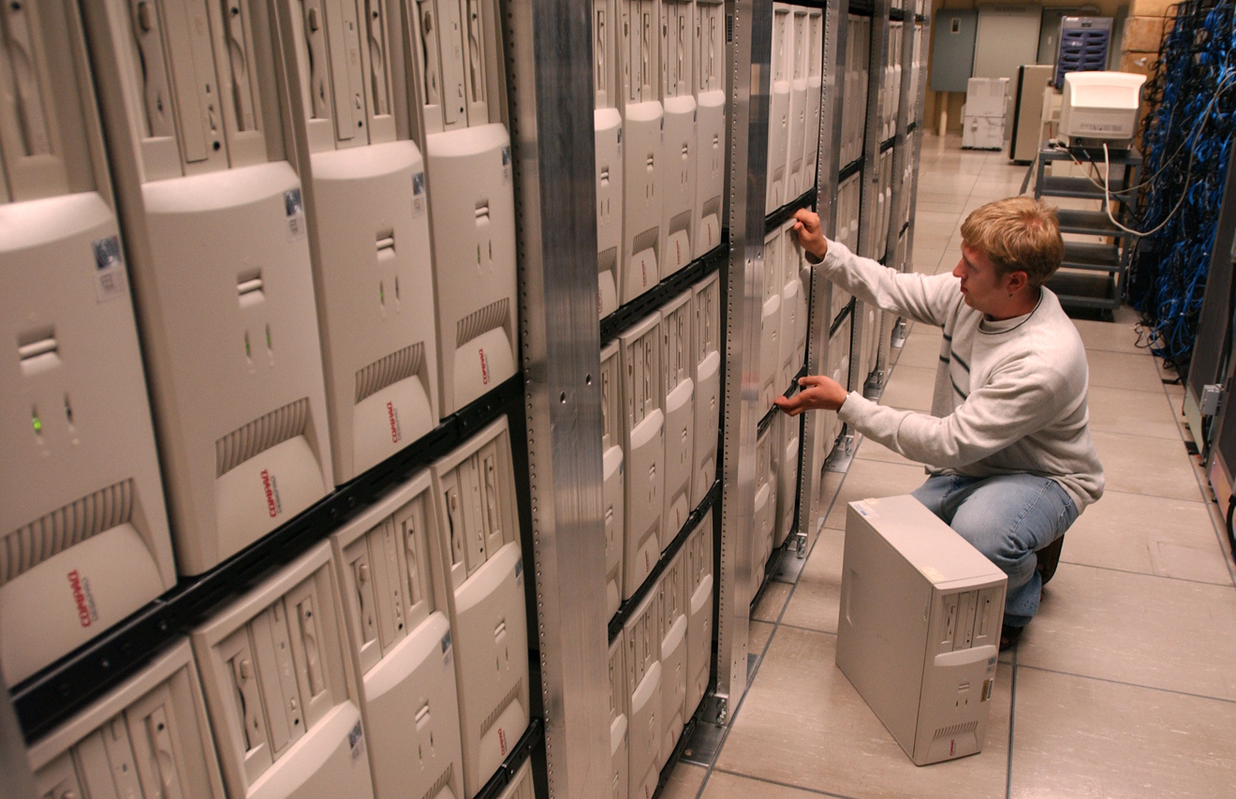
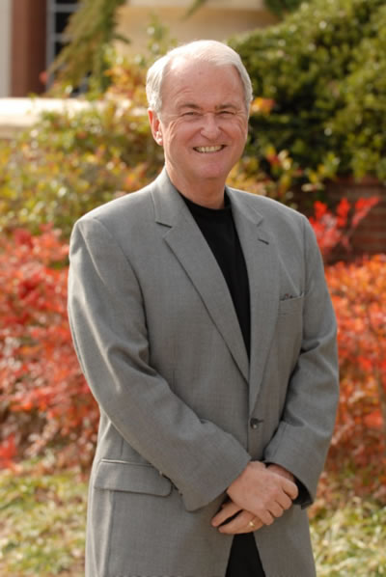
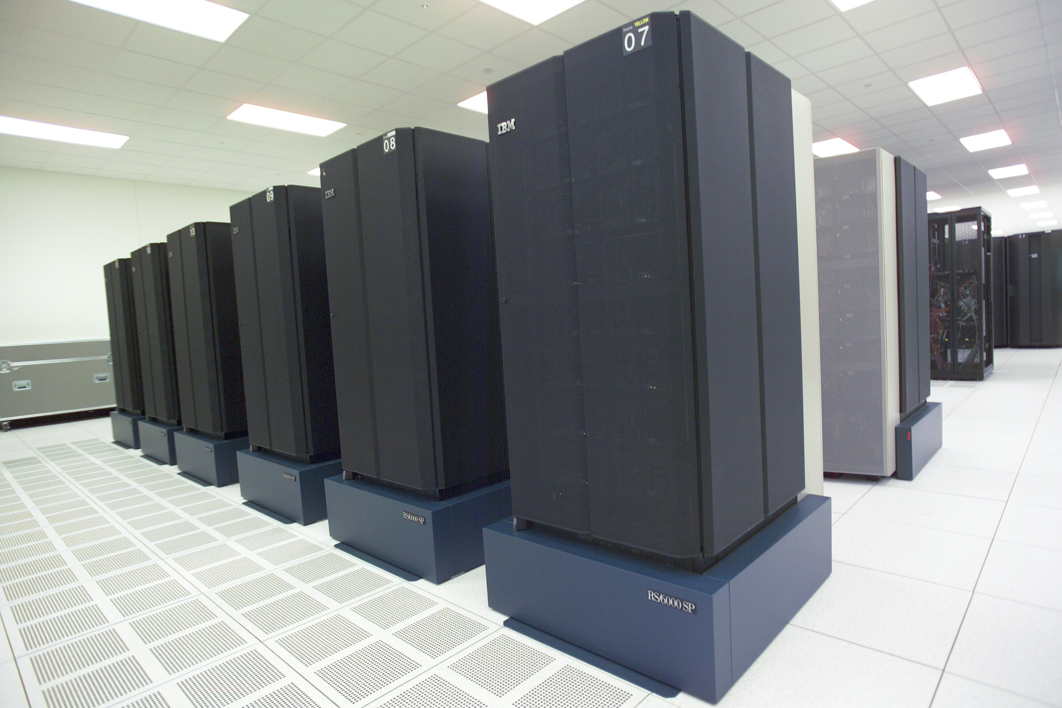
Purdue, circa 2001
Office of the VP for IT formed, first CIO
Jim Bottum hired from NCSA as first CIO
Administrative IT and computing center merged, forming ”IT at Purdue” (ITaP)
Prior to hiring of CIO, computing and storage capacity was behind where it should be, newest compute resource was an 8-year old IBM SP
Getting research computing in order was a top priority
Got into the “Beowulf” world, and started our “Community Cluster” condo program ~2004 or so
https://commons.wikimedia.org/wiki/File:ORNL_History_(31550428397).jpg

Slide 10
To All Stakeholders:
We are addressing the ~2001 lack of capacity and driving costs down
Hardware Investment:
$ per CPU Hour

Slide 11
To All Stakeholders:
The capacity that we’ve invested in is well-used
124% average annual growth on the number of
computational hours used by Purdue faculty
Grid computing: 30M↑
from 18M hours (2008)
Storage: 2,588 TB↑
from 1,904 TB of capacity (2009)
HPC: 113M↑
from 67M hours (2009)

Slide 12
To Faculty, Academic Leaders:
Who is Using the Cyberinfrastructure?

Slide 13
To Faculty and Academic Leaders:
Our investments have tangible benefits to your output, by lowering time to science
AVERAGE WAIT TIME ALL CLUSTERS
206
83
61
MMinutes
40%
39%
45%
23%
25%
45%
15%
23%
25%
4%
4%
4%
6%
9%
9%
11%
13%
13%
15%

Slide 14
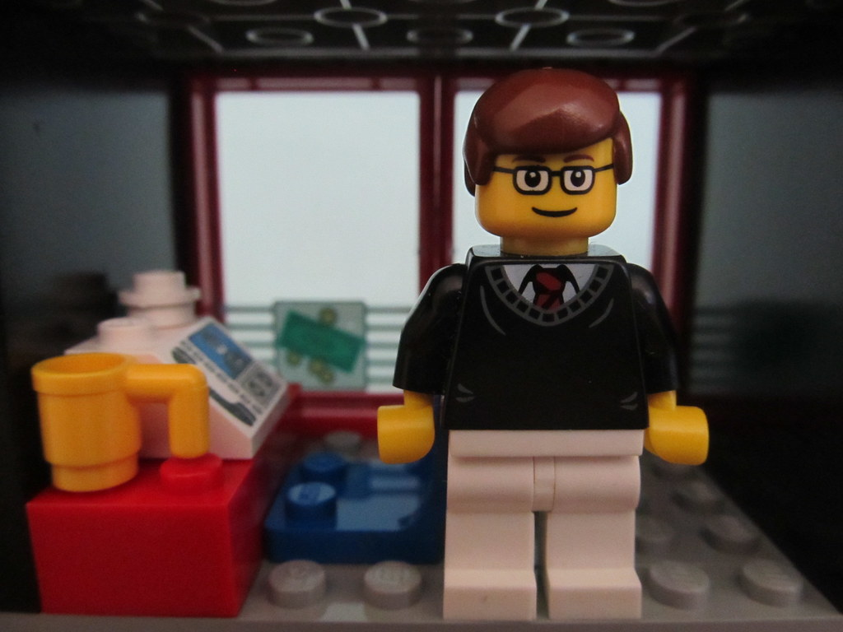
Are You Cost-Effective?
Variations of these questions include:
Why don’t you use the cloud?
Didn’t you just buy an HPC system?
How is this different than the other thing you just got?
… or that INSERT PEER HERE just got?
https://www.flickr.com/photos/85567416@N03/14224208945

Slide 15
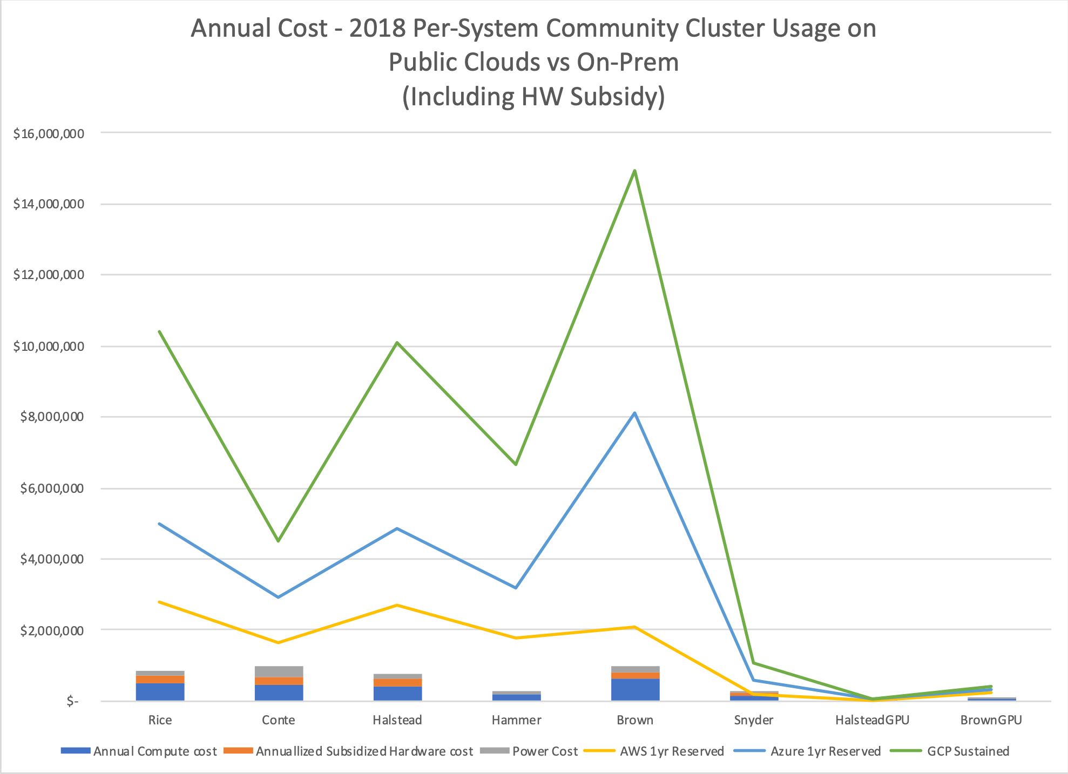
To CFO and Faculty:
Our model is more cost effective than commercial cloud (2019)

Slide 16
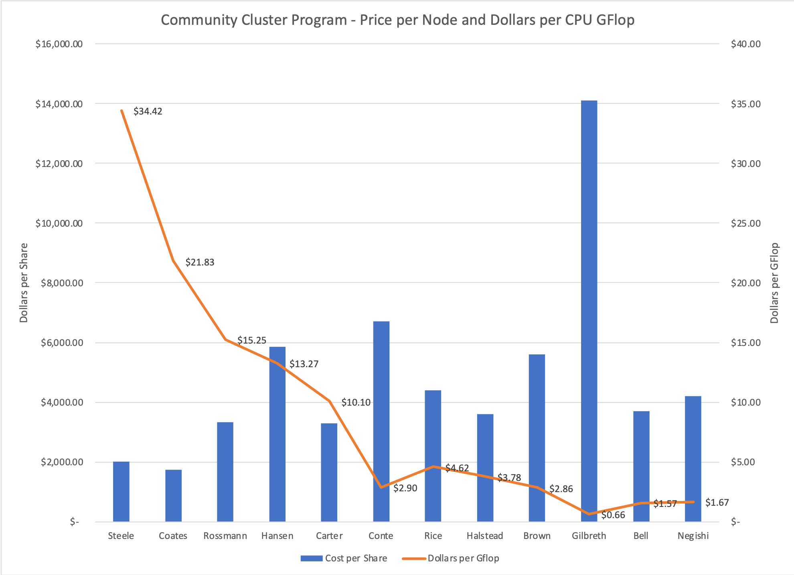
To CFO, and Faculty:
Each iteration gets us more capability per dollar

Slide 17
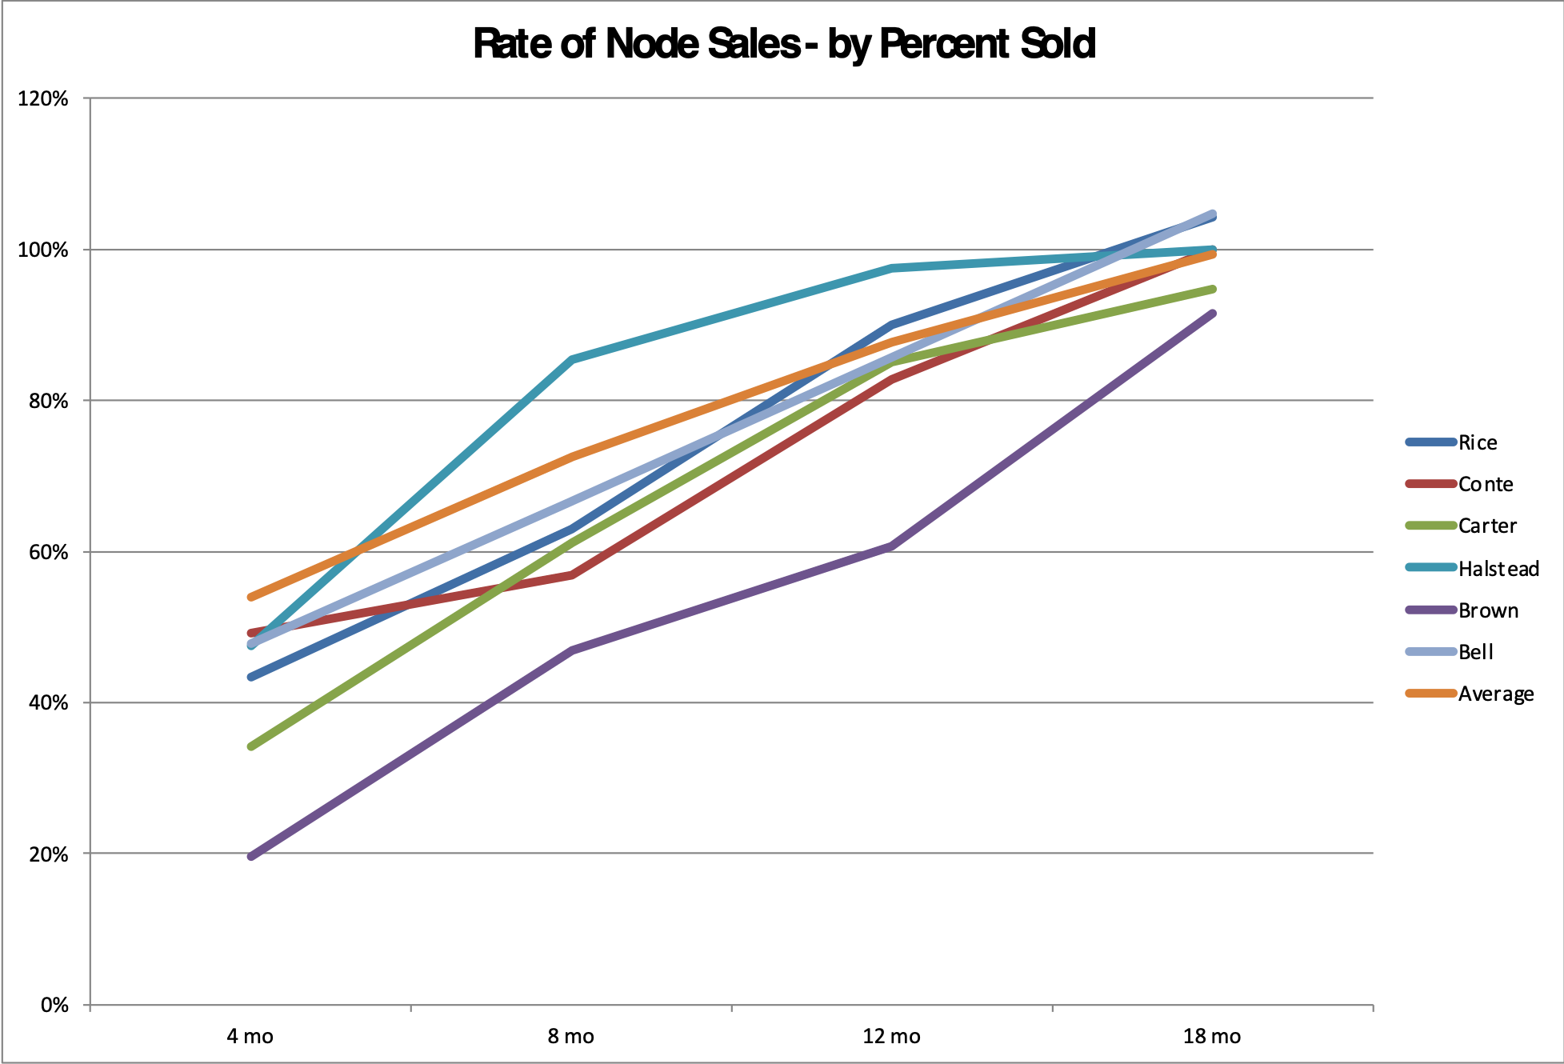
To All, but mostly CIO and CFO:
We understand our sales data well enough to plan our lifecycle needs

Slide 18
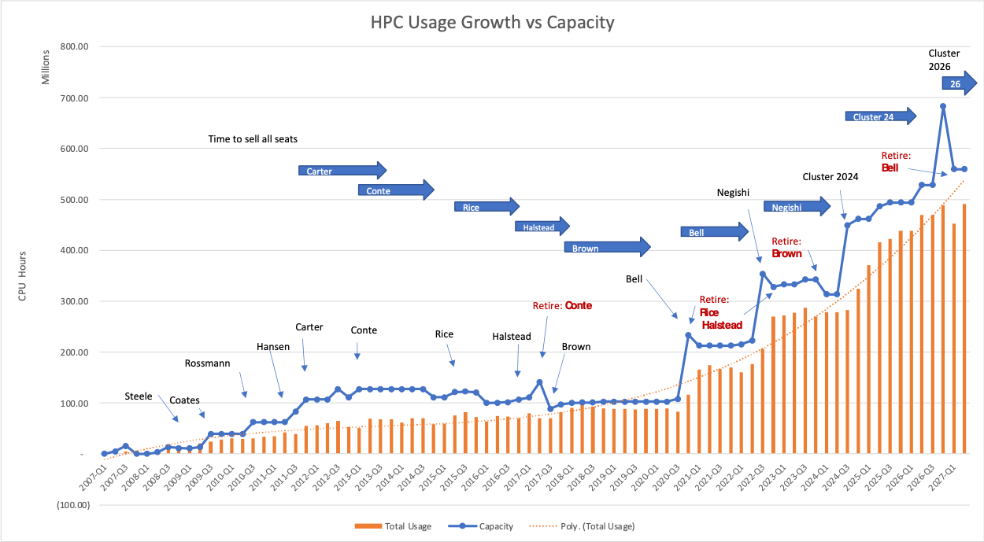
To CIO and CFO:
We understand our sales and usage patterns well enough to plan our lifecycle needs

Slide 19

Are You a Partner?
From Purdue’s 2002 IT Strategic Plan
Project has to be part of University’s strategic direction
Work out priorities with the VPR
Extra points for interdisciplinary projects
Consistent with Purdue strategic directions
Funding potential
Two approaches to proposals
Both sides have something to gain (in each other’s critical path)
In addition to monetary
Project should be innovative
Write it down (project management)
Resources (have done loss leaders but…)
Loss leaders early to establish credibility

Slide 20
To Faculty and Academic Leaders
We are active partners with faculty on research projects, and an enabler
$10,748,181
$7,176,556
$862,011
$1,320,000
*Includes total amount of grants that have an ITaP PI/Co-PI.

Slide 21
To Faculty and Academic Leaders
Our partners cite our center as necessary to their proposals

Slide 22
To Faculty, Academic Leaders, CFO
An increasingly large proportion of the research dollars go to users of HPC
Percentage of research awards involving High Performance Computing
23%
25%
39%

Slide 23
To Faculty, Academic Leaders, CFO
An increasingly large proportion of the research dollars go to users of HPC
PERCENTAGE OF AWARDS TO
HIGH-PERFORMANCE COMPUTING USERS
3%
5%
6%
9%
13%
10%
13%
19%
19%
20%
21%
24%
27%
23%
26%
32%

Slide 24
To Faculty, Academic Leaders, CFO
An increasingly large proportion of the research dollars go to users of HPC

Slide 25
To the CFO
Users of our center pay most of the university’s F&A

Slide 26
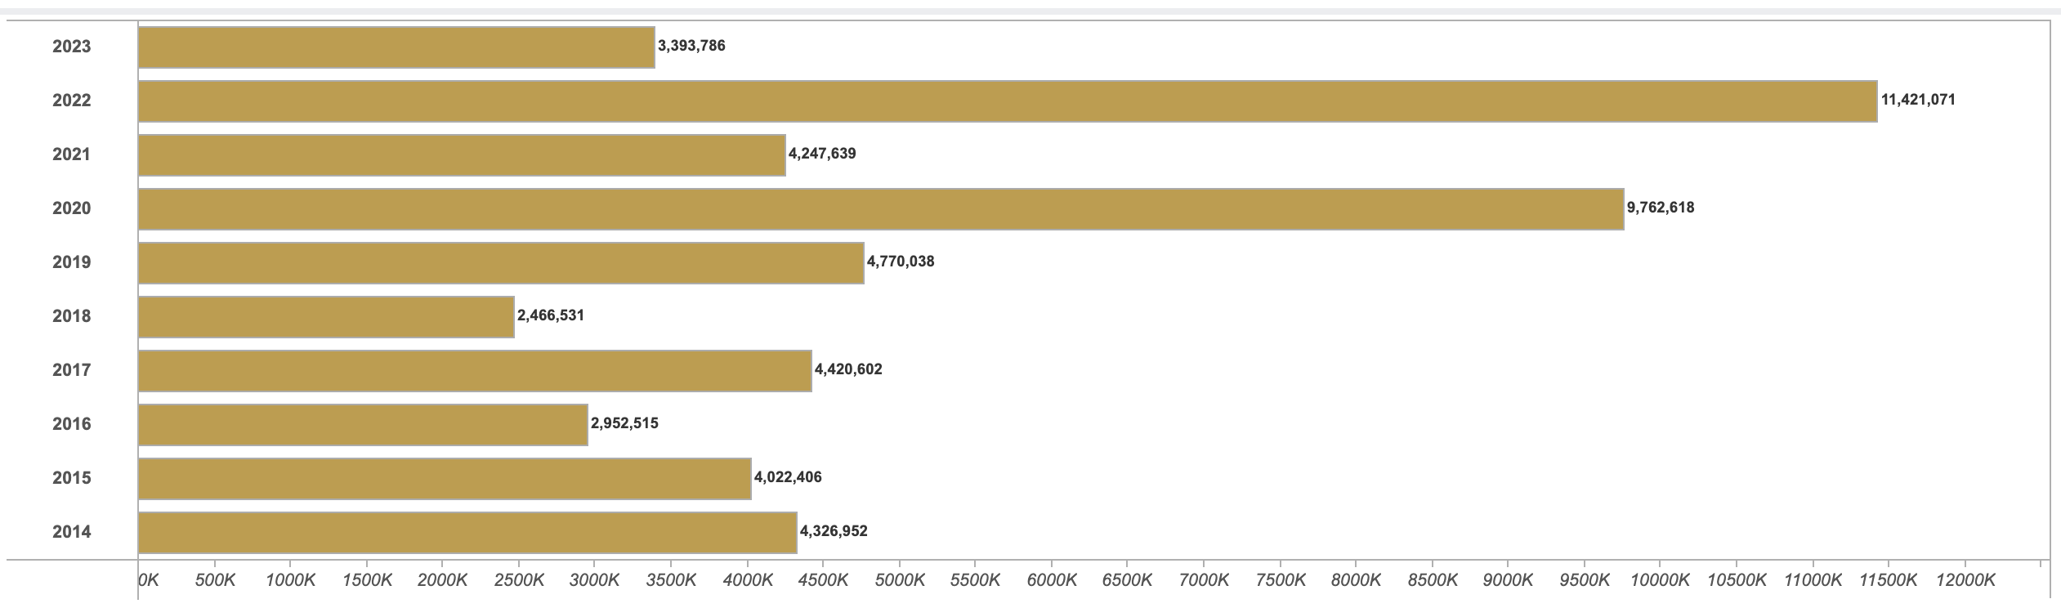
To all:
By 2023, we are a source of sponsored research dollars on our own, and still in partnership with faculty
Research Awards to RCAC PIs, by Fiscal Year

Slide 27
To all:
Institutional investment in research scientists and RSEs has a positive ROI

Slide 28
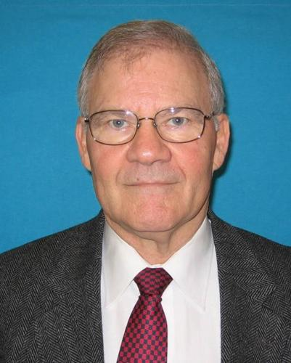
Are your Metrics Tied to a Product?
Sage Advice
Last CIO: “Raw count metrics are meaningless to the administration unless related to the business of Purdue. You need to talk about the value in those terms”
That Administration’s Priorities:
Control Costs (tuition freeze)
Impact Students
Recruit and retain faculty

Slide 29
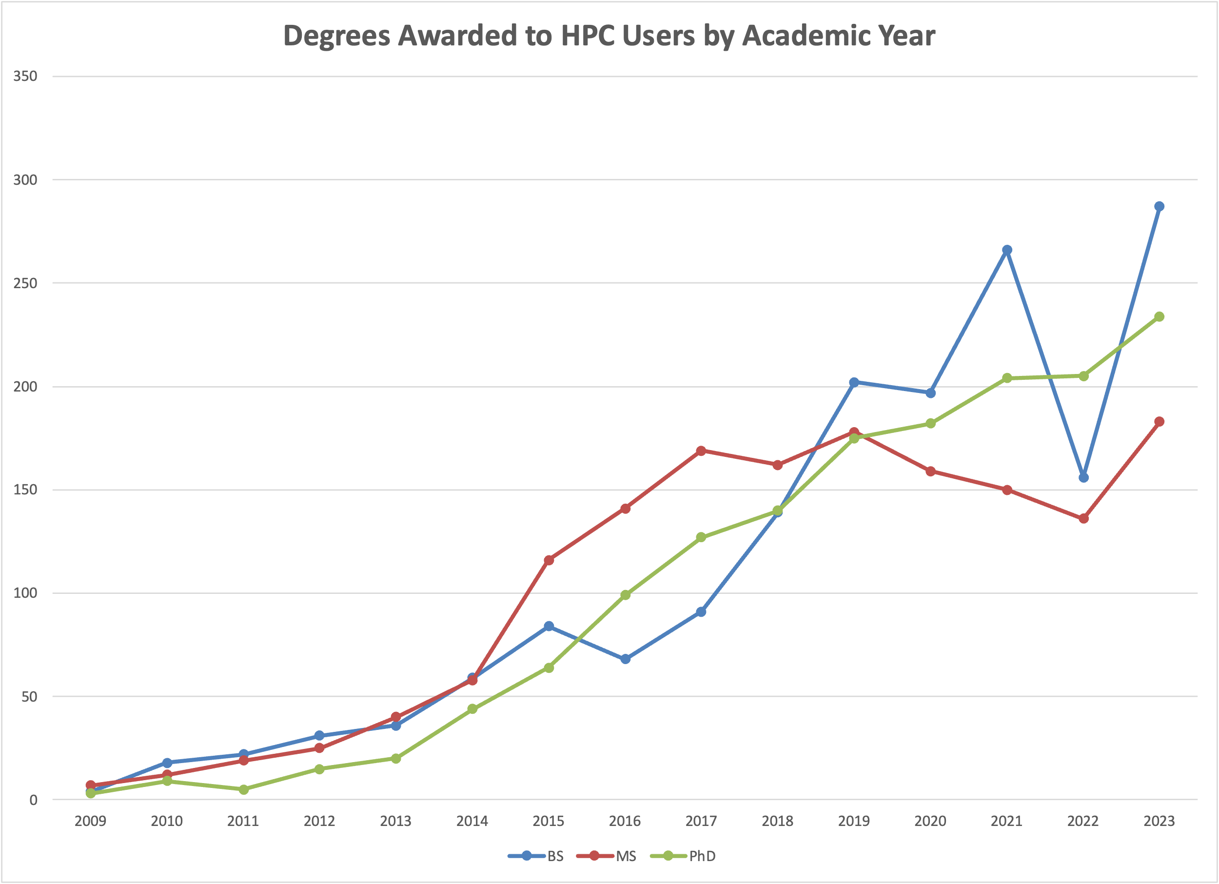
To Faculty and Academic Leaders
To train students, CI resources are critical tools to have available

Slide 30
To Faculty and Academic Leaders
To train students, HPC resources are critical tools to have available
During the 2022-23 AY, 167 courses used HPC for instructional purposes, impacting a total of over 3000 students.

Slide 31
To the CFO
The general fund costs for campus CI enable research expenditures have a high ROI

Slide 32


Step 3: Get Testimonials
Don’t underestimate the power of qualitative data
Notes:
These people are the ones who will be your advocates to your provost, president, deans

Slide 33
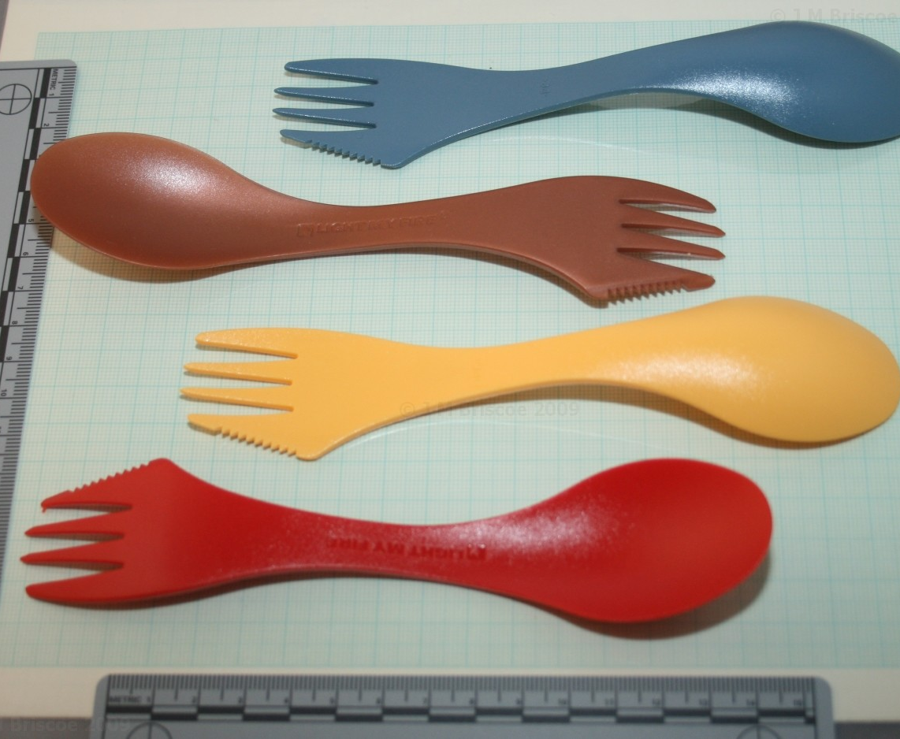
Before: (~2006)
“I’d rather remove my appendix with a spork than let you people run my research computers.”

Slide 34
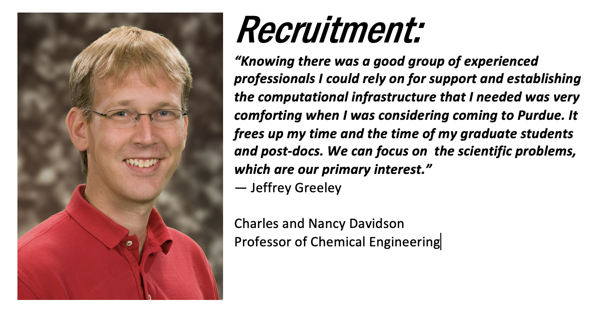
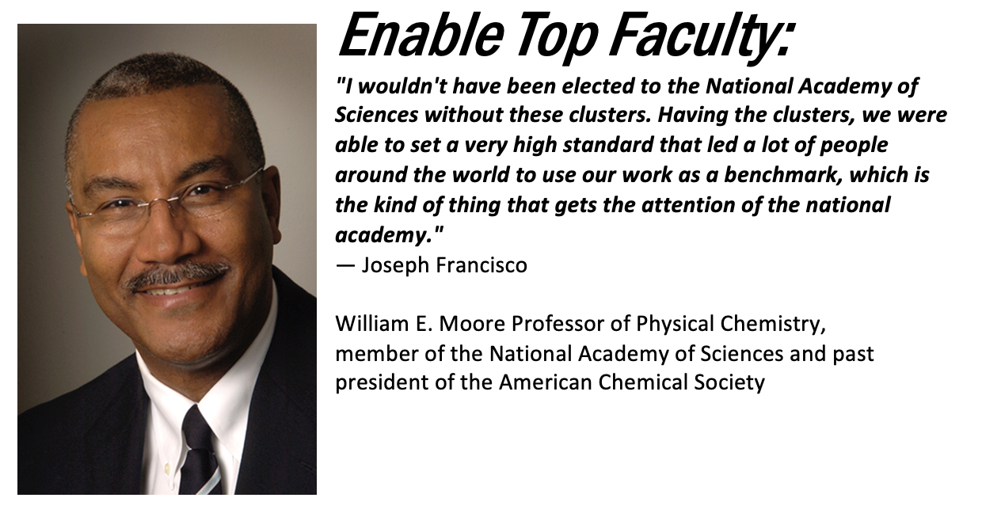
Testimonials

Slide 35

Production Function Model
Some guy did some research on the value proposition…

Slide 36
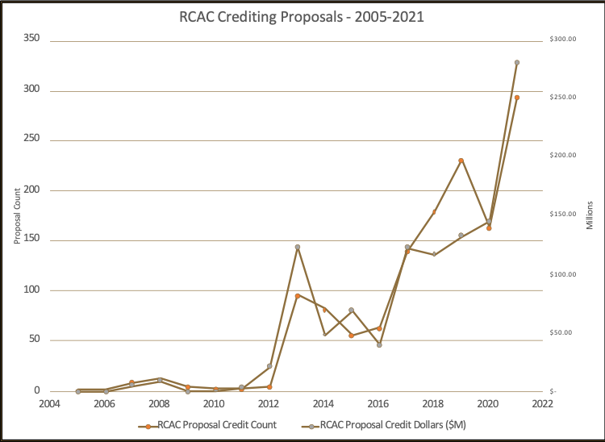
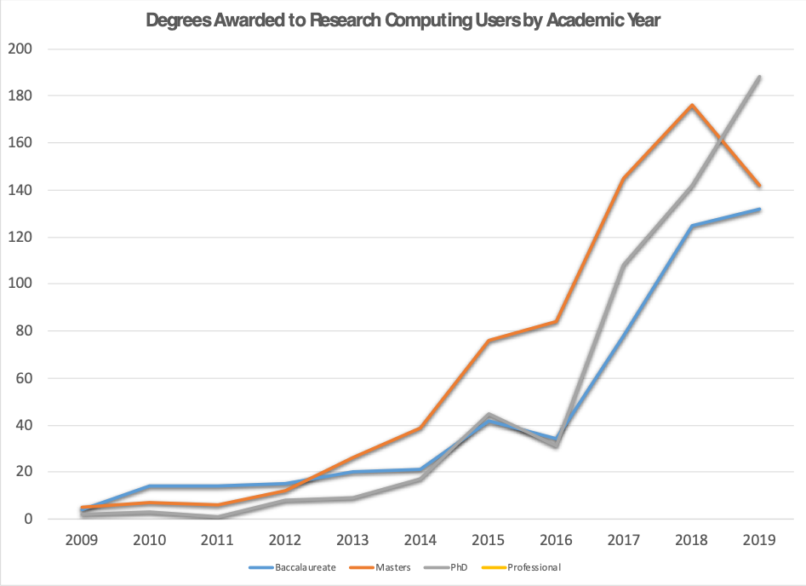
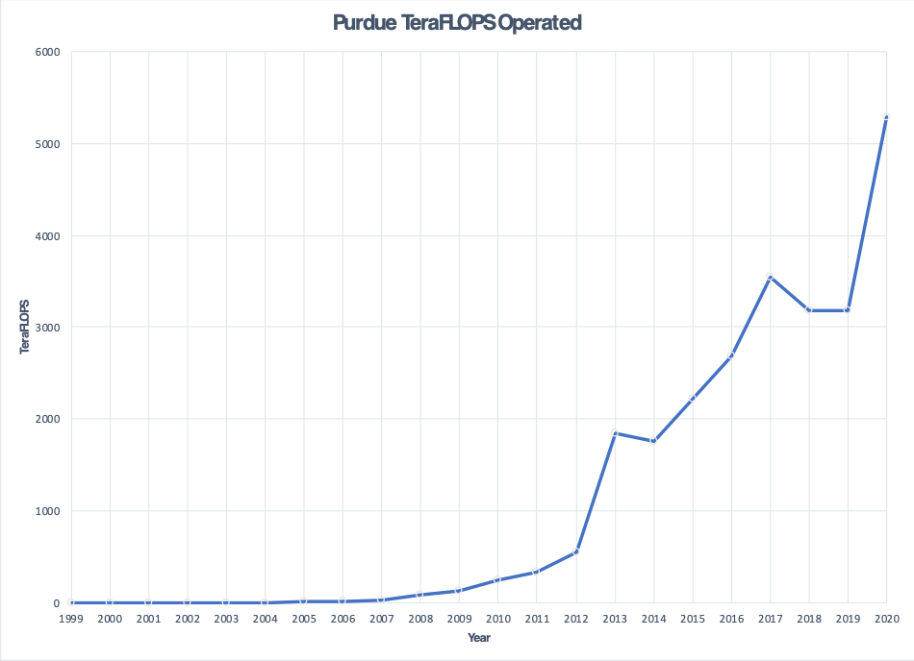
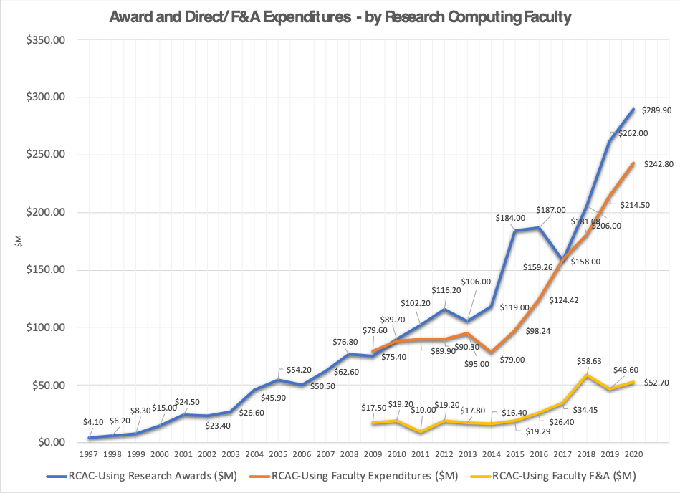
Motivator: Metrics at Purdue
CI-using awards, degrees, proposals all take huge jumps in 2012-2014
What happened there?
Carter (our first big cluster) came online in late 2011.
Conte (#28 on Top 500) in early 2013
This prompted questions to me – did these investments contribute to increase in outputs?
Understanding these relationships is critical to modeling the impact of the investment!

Slide 37



Research Questions
Does institutional investment in campus CI facilities lead to a measurable impact on institutional output?
If so, what are the key factors for investment that lead to returns on institutional outputs?
What is a model for quantifying the impact of campus cyberinfrastructure investments?

Slide 38


Background
Work by Amy Apon
(2010): Presence of a Top 500 supercomputer on a campus (an input) positively impacts research output at the institutional level.
(2015): Departments in Chemistry, Civil and Environmental Engineering, and Physics are more productive in universities with local cyberinfrastructure.
Downsides: Top 500 is no longer a viable proxy for investment.
How to add a labor dimension in model? No cross-institutional data available as to investment.

Slide 39
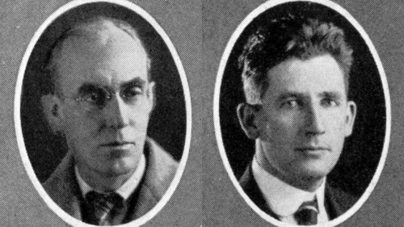
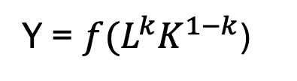
Production Function Model
In the 1920s, theories of production described the amount produced depended upon the level of technological knowledge and the quantities of the factors of production.
Cobb and Douglas (1927) described a least squares regression equation that predicts production (Y) based on inputs of capital (K) and labor (L),
Y = ${f(L}^{k}K^{1−k}$)
“We found the values of k and 1-k by the method of least squares to be .75 and .25…”
Paul Douglas, Autobiography (1971)

Slide 40
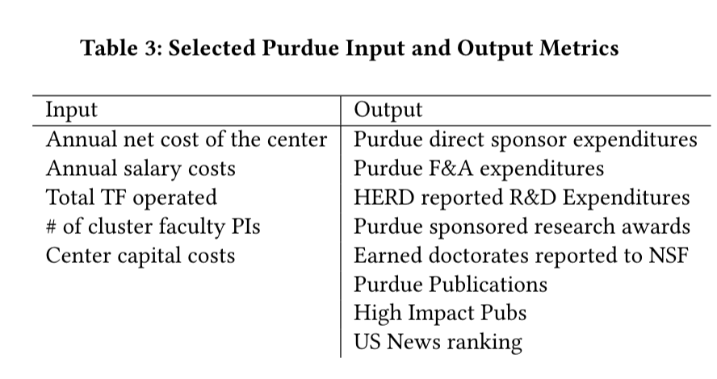
Inputs and Outputs
What to use for Labor, Capital, and Outputs?

Slide 41
Correlation Analysis
For Single Inputs TF and Salary
Output | Kendall Tau (TF) | Kendall Tau (Salary)
HERD Exp | 0.92 | 0.88
Awards | 0.83 | 0.75
Earned Doctorates | 0.90 | 0.77
Purdue Pubs | 0.90 | 0.32
Hi Impact Pubs | 0.85 | 0.87

Slide 42


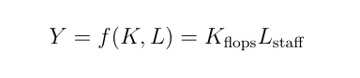
Regression Models
With Multiple Inputs Predicting an Output
With the proxies for labor and capital identified, use the production function form (labor + capital) to model the various outputs.
For example, TeraFLOPS + staff salaries to predict outputs
.. And another series of regressions to model the capability of the labor variable, using research expenditures by center staff as a metric.

Slide 43
Output – HERD Expenditures
Input | HERD Exp ($M) | % Variance Explained
100 TeraFLOPS | 2.59 | 25%
$100k Salaries | 9.04 | 43%
$100k RCAC Grants | 2.34 | 28%

Slide 44
Output – Earned Doctorates
Input | Earned Doctorates | % Variance Explained
100 TeraFLOPS | 2.55 | 31%
$100k Salaries | 7.36 | 42%
$100k RCAC Grants | 1.27 | 22%

Slide 45
Implications for Policymakers
Results, Summarized
Investments in both systems and people lead to measurable returns to the institution
Labor accounts for the largest amount of the variation in all models
When optimizing for publication-based outputs, salary investment yields strong returns
Allowing (or encouraging) HPC center staff to be PIs on their own grants or with faculty yields dividends to the institution

Slide 46
Broader Applications
How can this framework be applied to other CIs?
Work ongoing to apply model to other campus’ data.
Some friendly institutions have shared
Can I talk to you about your data?
Improve the model – use timeseries statistics
Apply model to NSF XSEDE infrastructure
Using all NSF expenditures, US Earned Doctorates, NSF-funded pubs in Scopus, etc.

Slide 47
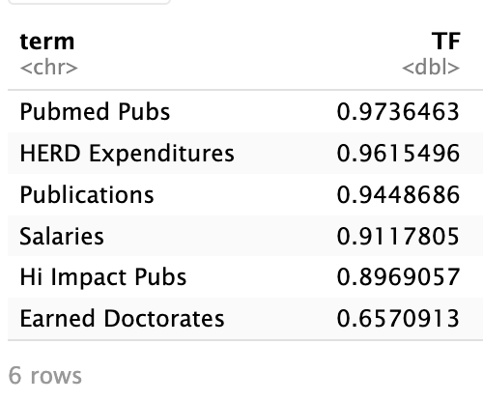
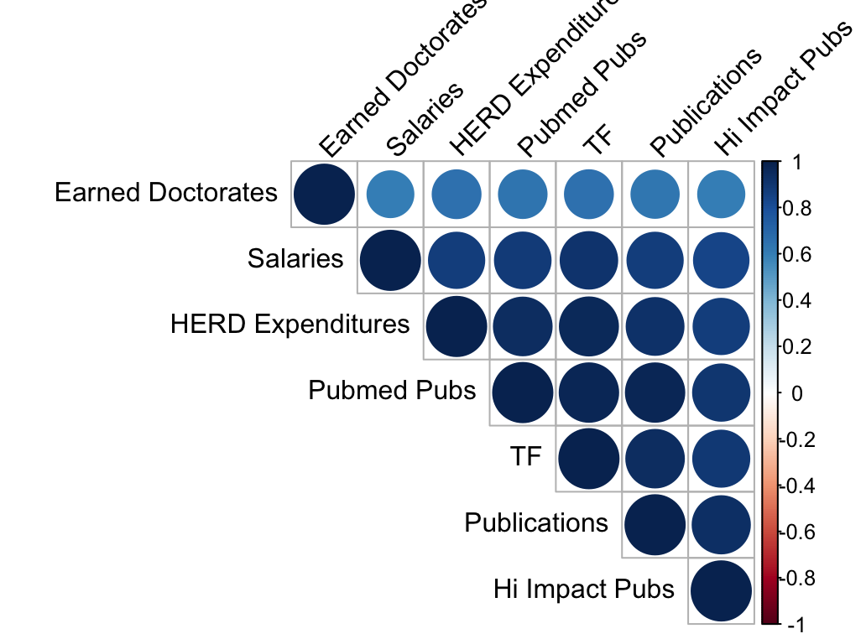
Institution 1

Slide 48
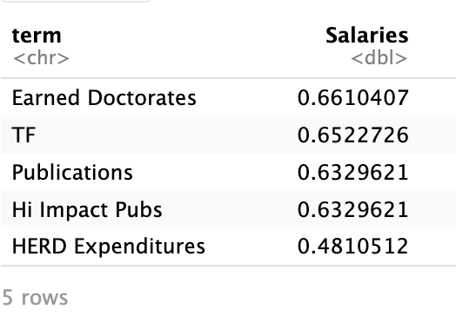
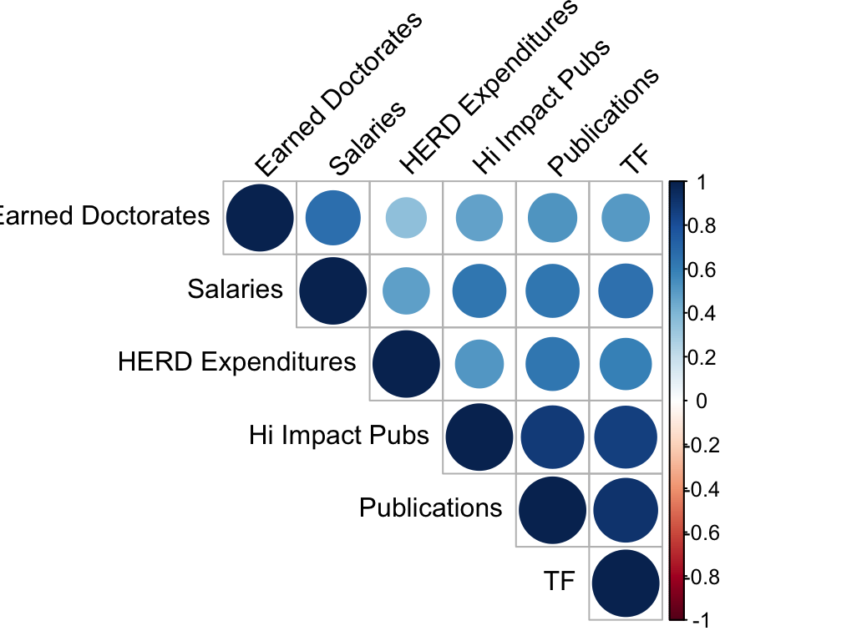
Institution 2

Slide 49
Thank You
psmith@purdue.edu

